Slide 1
Tips on exploring university academic resources
Shangxue Li, Aibo Li, Chuhan Zhang, Jiayi Deng

Slide 2
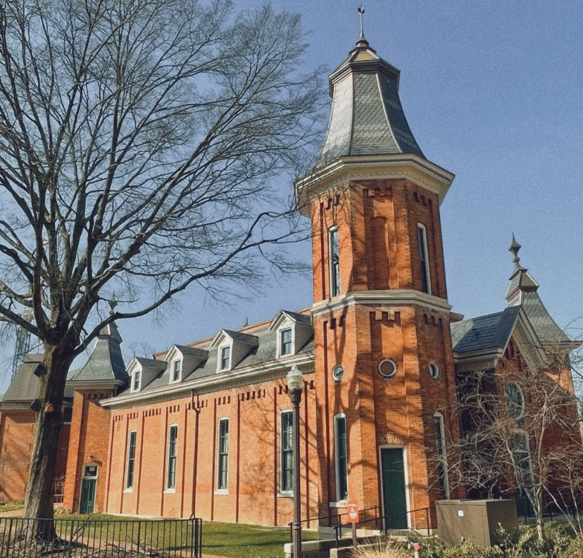
Introduction
The purpose of this project is to create a comprehensive university academic resources guide for students. The guide will focus on various aspects such as programs, internship opportunities, and curriculum. The guide will not only provide practical information but also offer strategies and tips for exploring university academic resources.

Slide 3
Methodology
1
3
Research
Generalization
Case Study
2

Slide 4

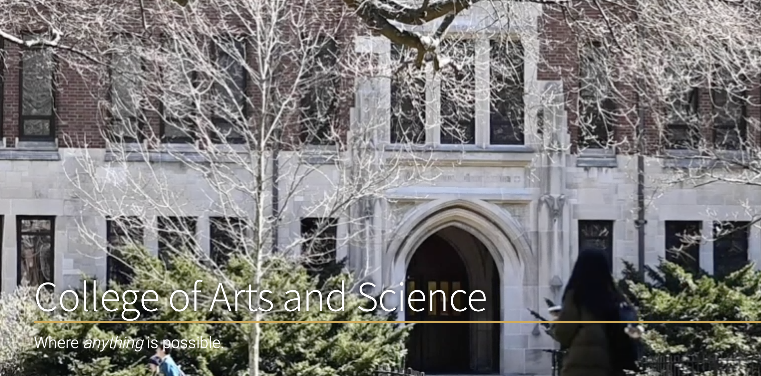
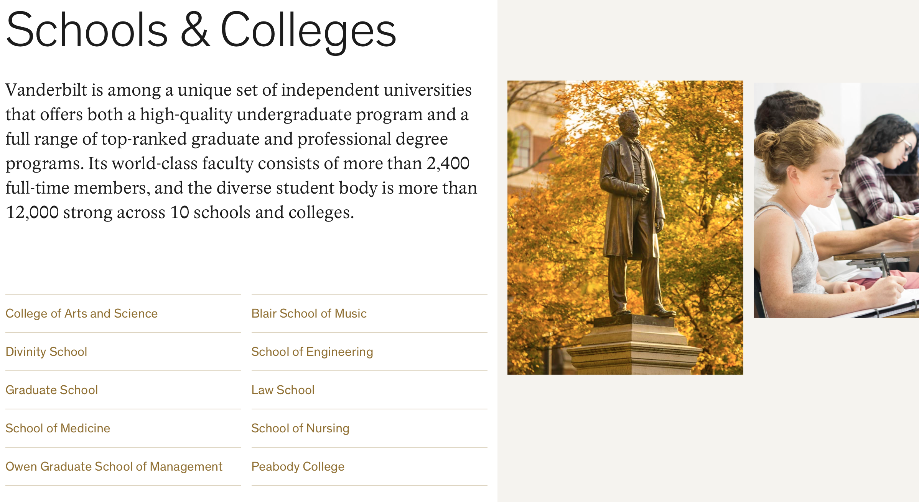
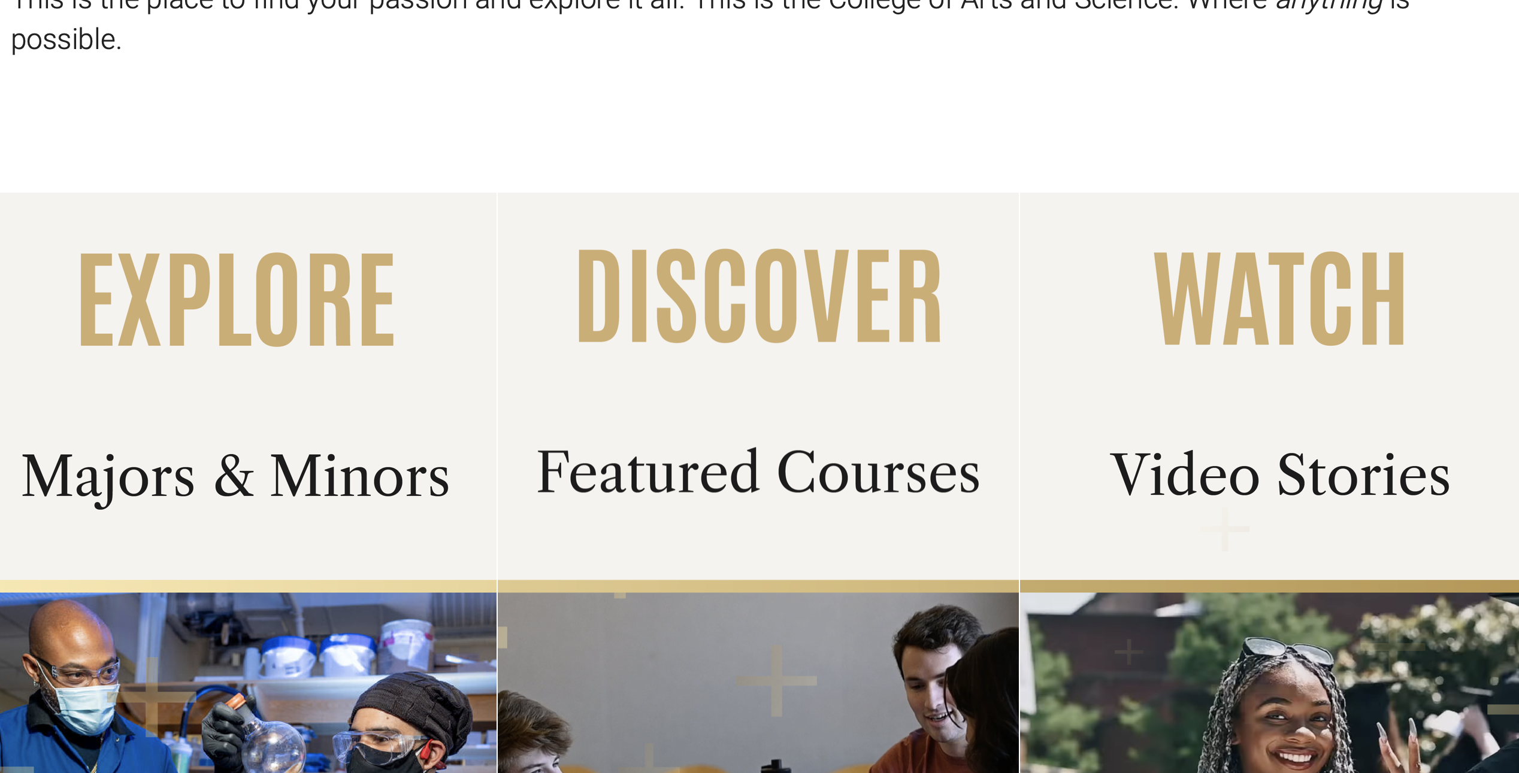
Curriculums
feature very prominently
usually can find in “Academic” section

Slide 5
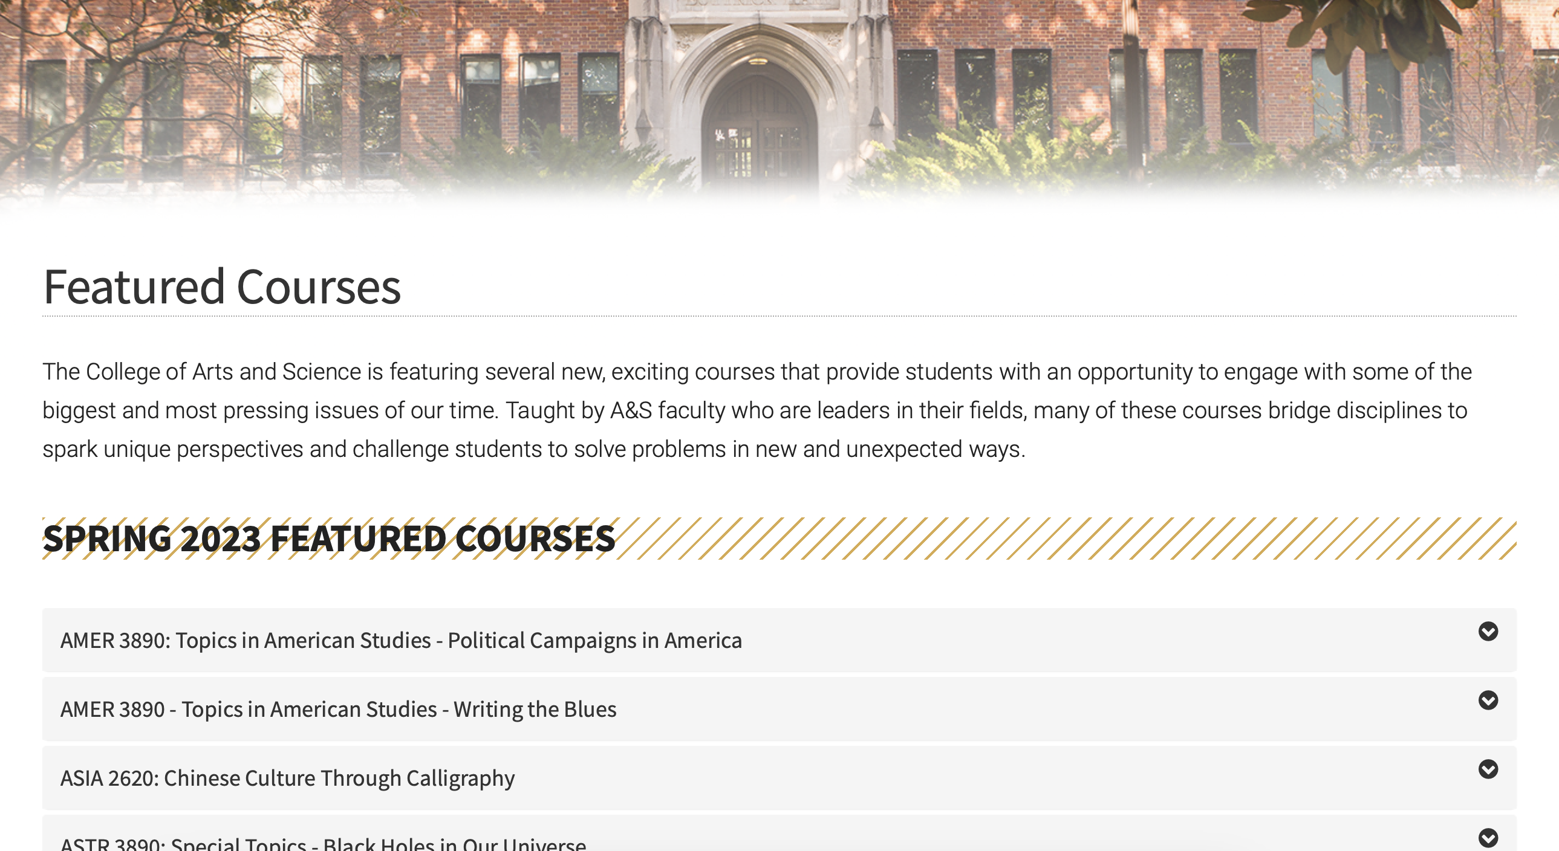
Curriculum
Click directly on the appropriate major link according to your needs

Slide 6
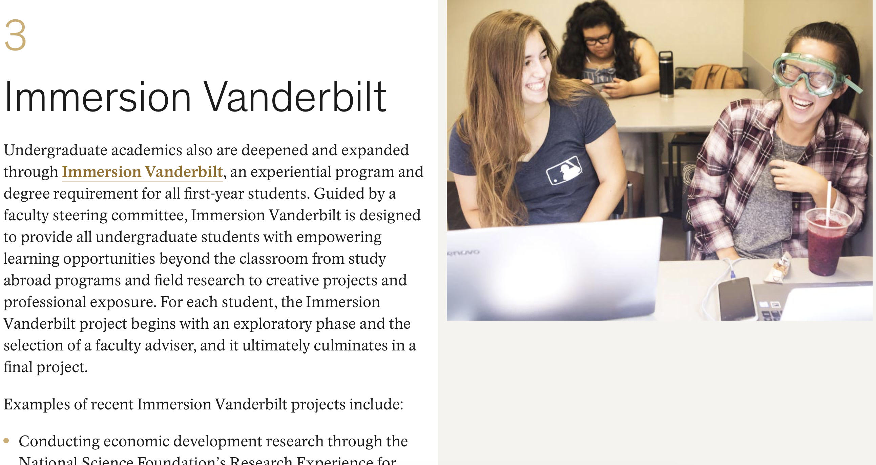
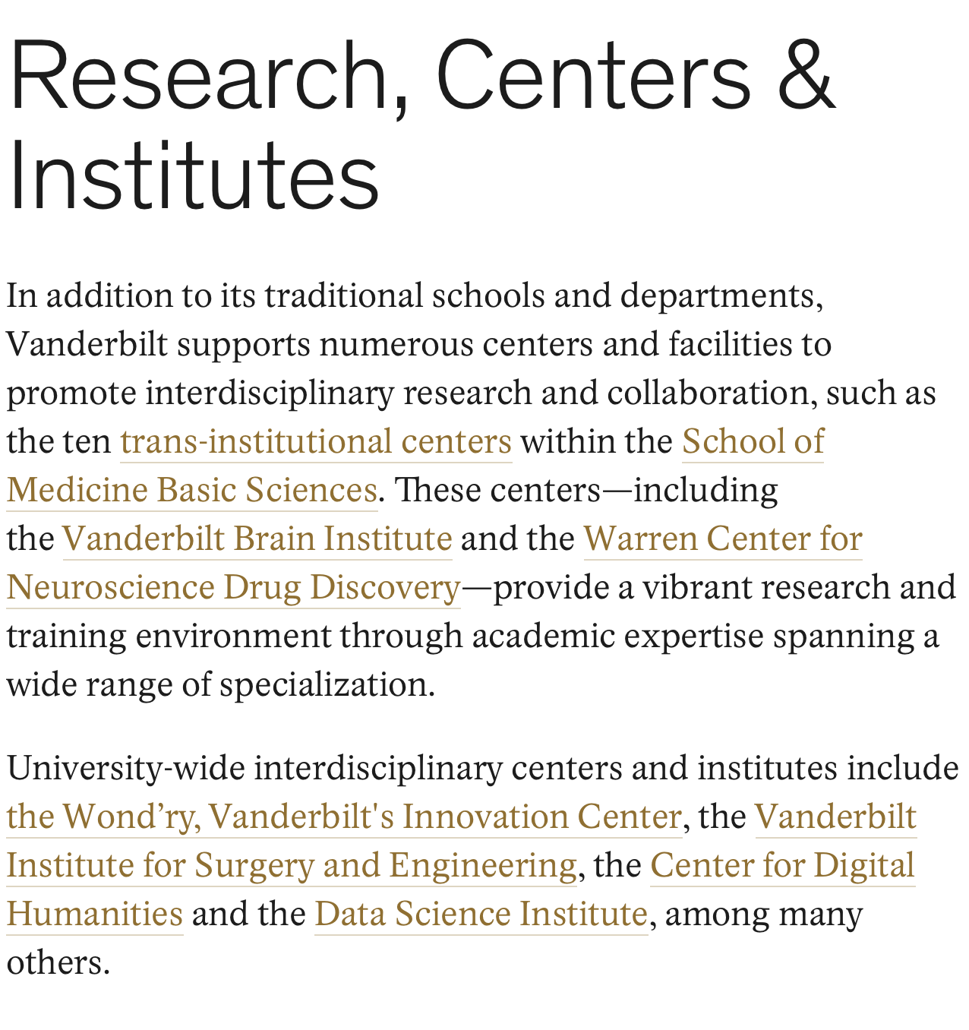
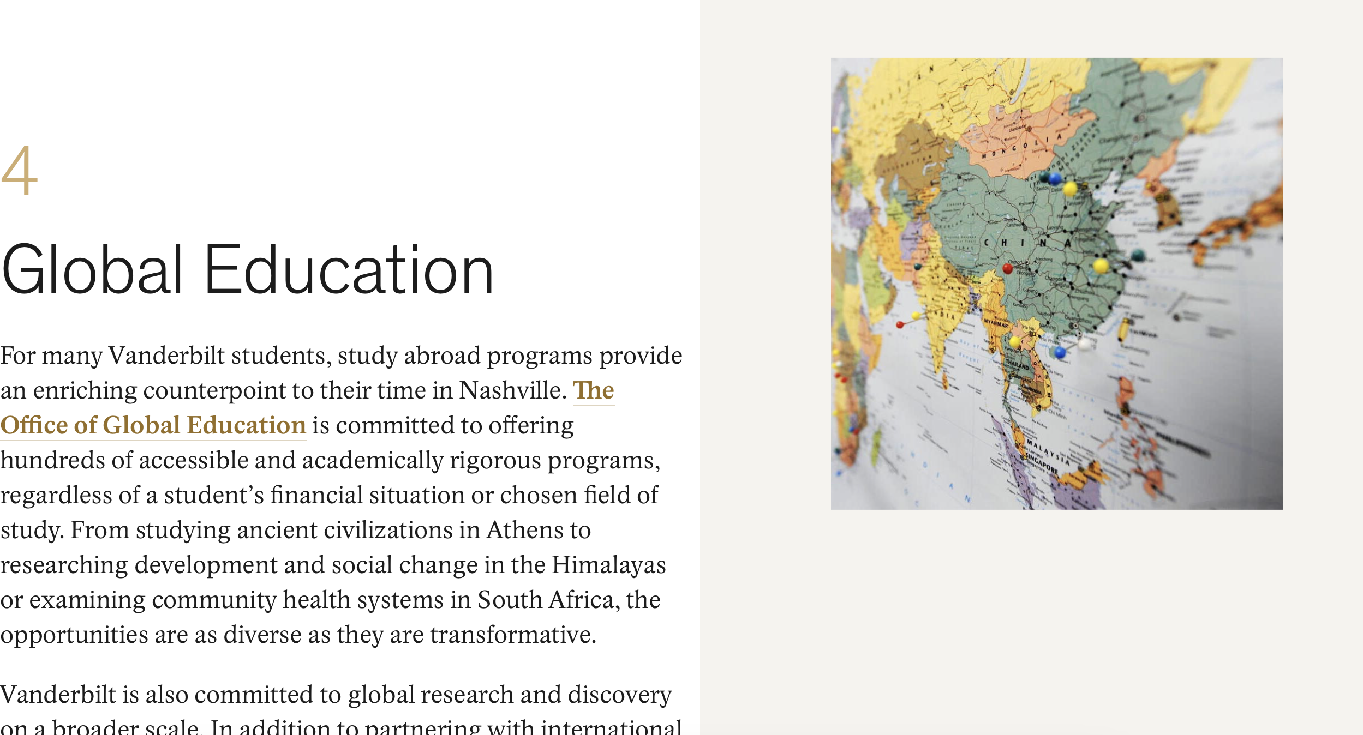
Programs
feature also very prominently
usually can find in “Academic” section

Slide 7
Internships
Career service center 
Career fairs 
Faculty and alumni
...

Slide 8
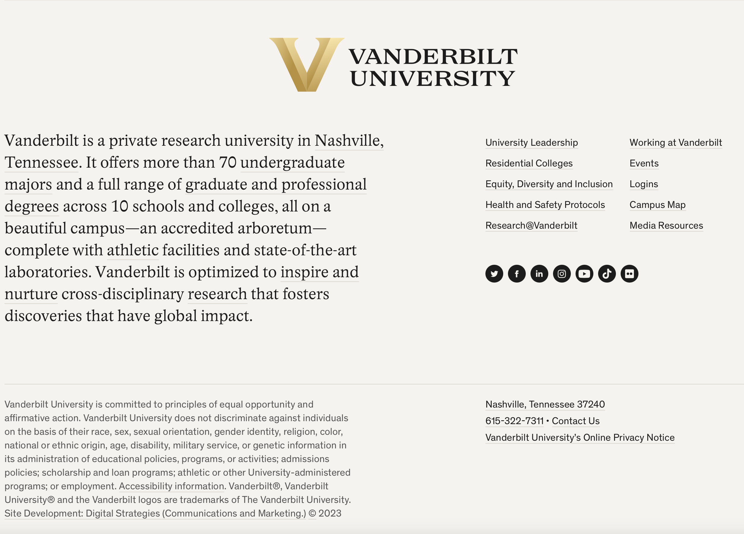
Characteristics
Does not feature very prominently
may have other names,
e.g “Working at Vanderbilt”

Slide 9
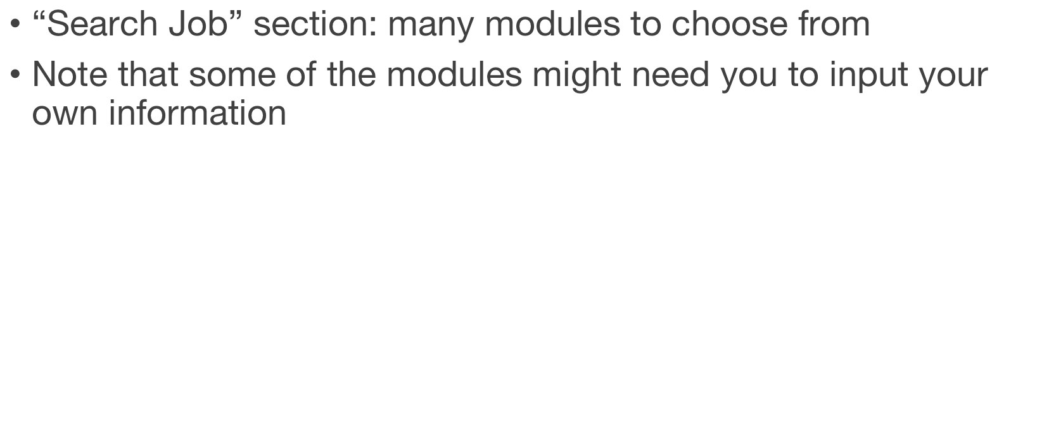
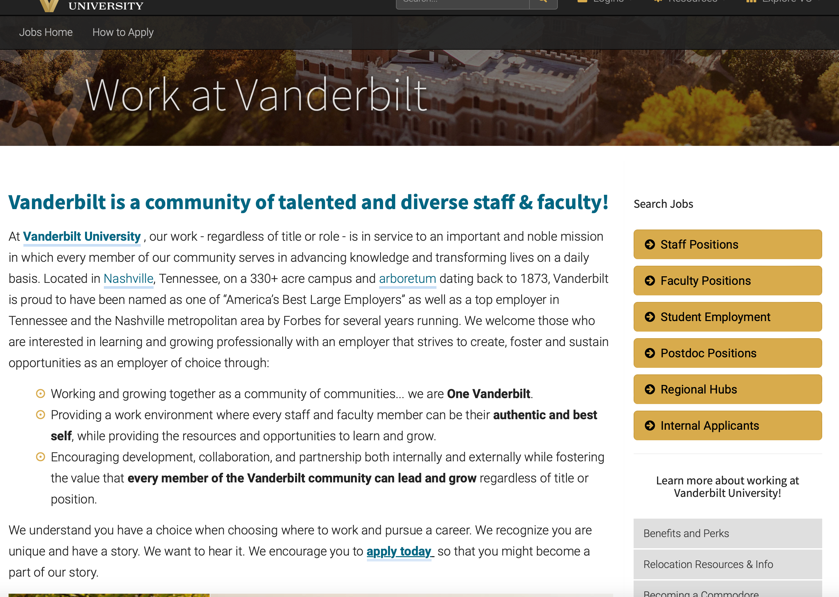
New Pages
Nunc viverra imperdiet

Slide 10

Libraries
Data base
Journals
...

Slide 11

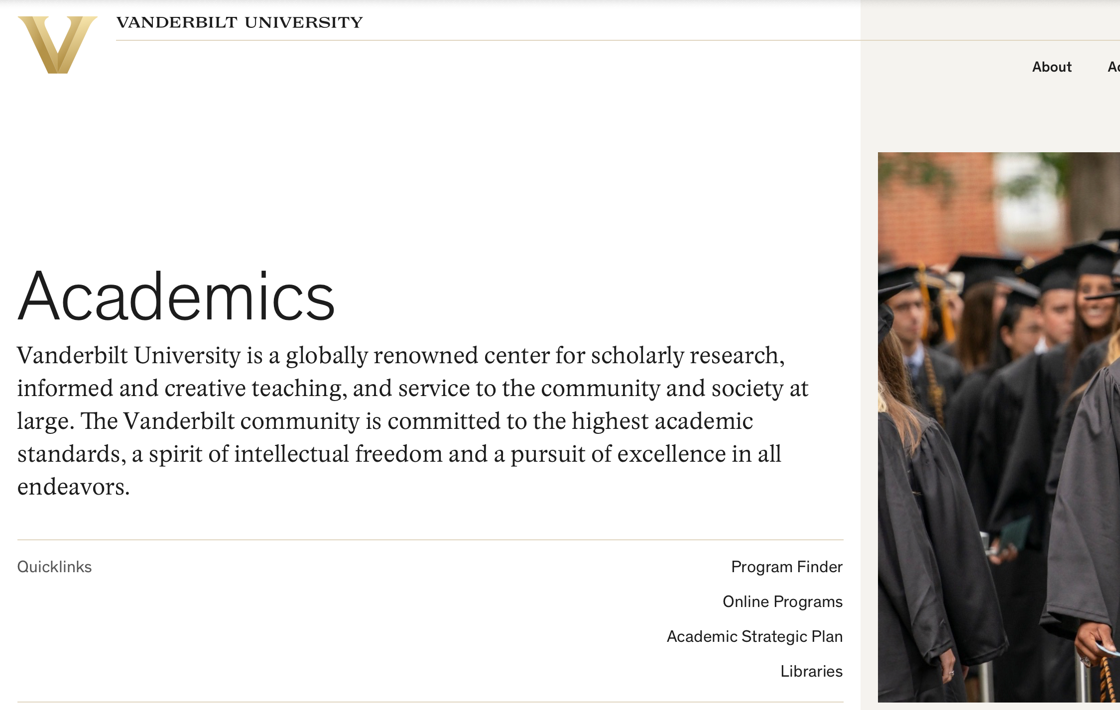
How to find it?
Click on the “Academics” icon
go to the detail page

Slide 12
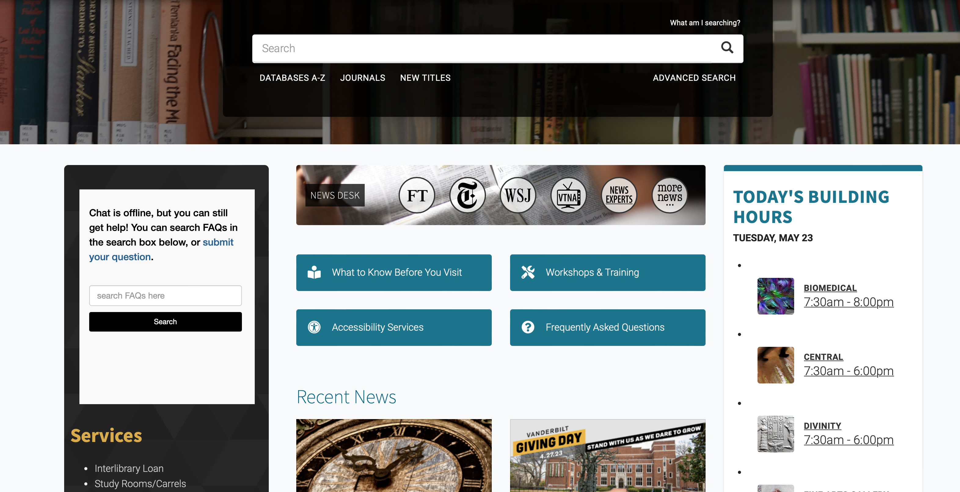
How to find it?
Click on “Libraries”

Slide 13
Other
Tutoring
Study groups
Writing centers
……

Slide 14
How to research on these information?
Usually couldn’t be found on the front page of the website
“Academic”
Search

Slide 15
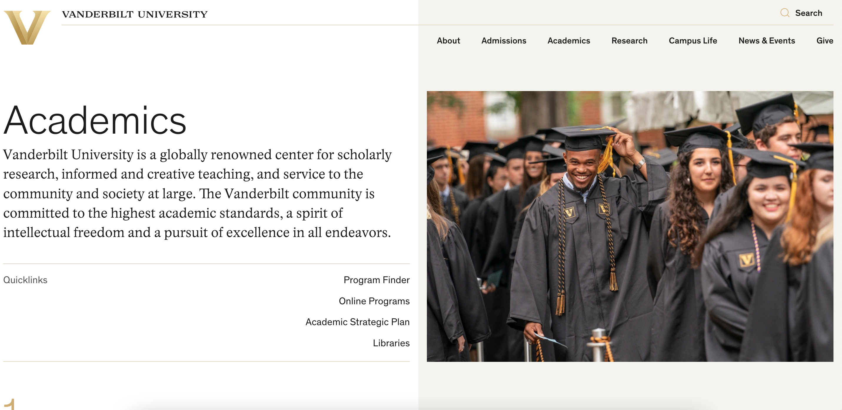
For Example:
Click into the academic page

Slide 16
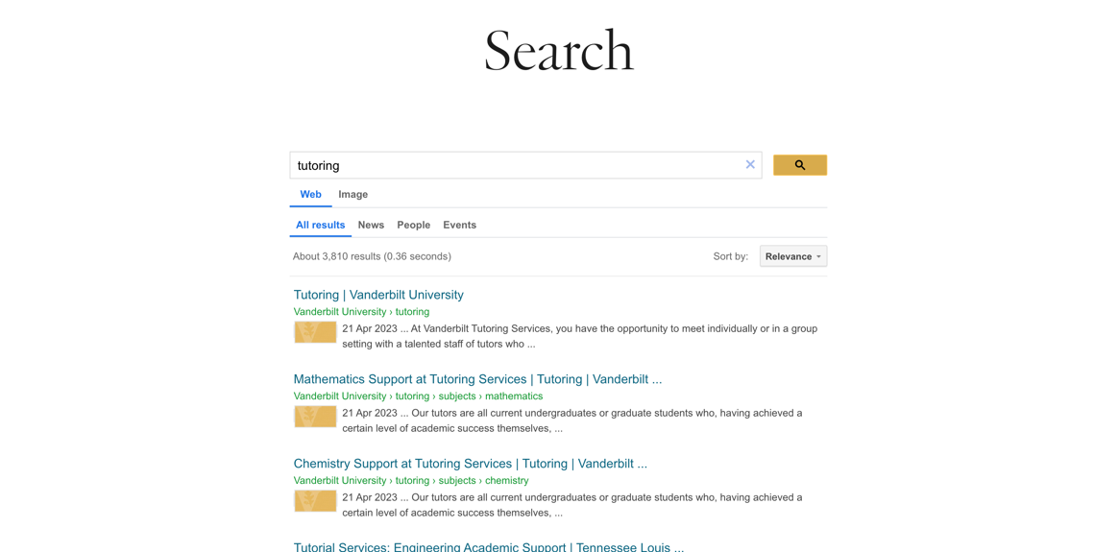
For Example:
Search
Type in keyword

Slide 17
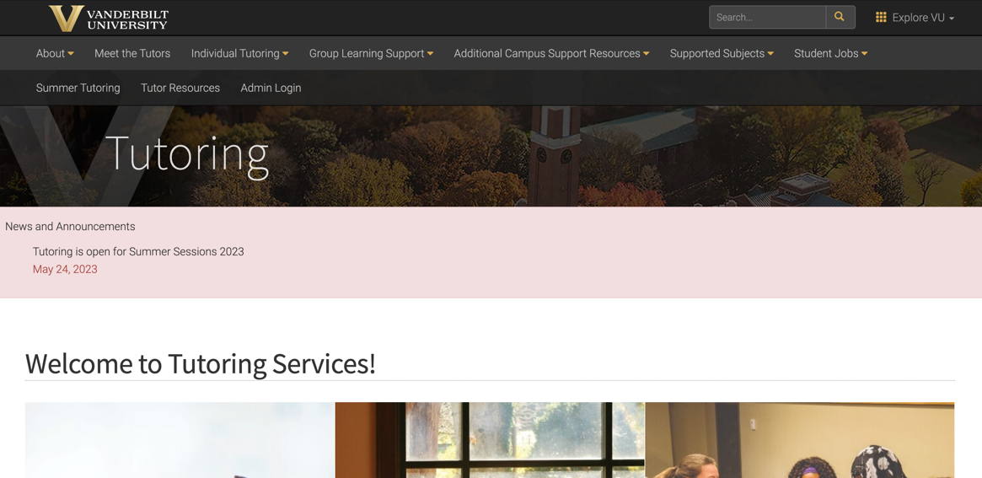
For Example:
Tutor resources
Schedule appoinments

Slide 18
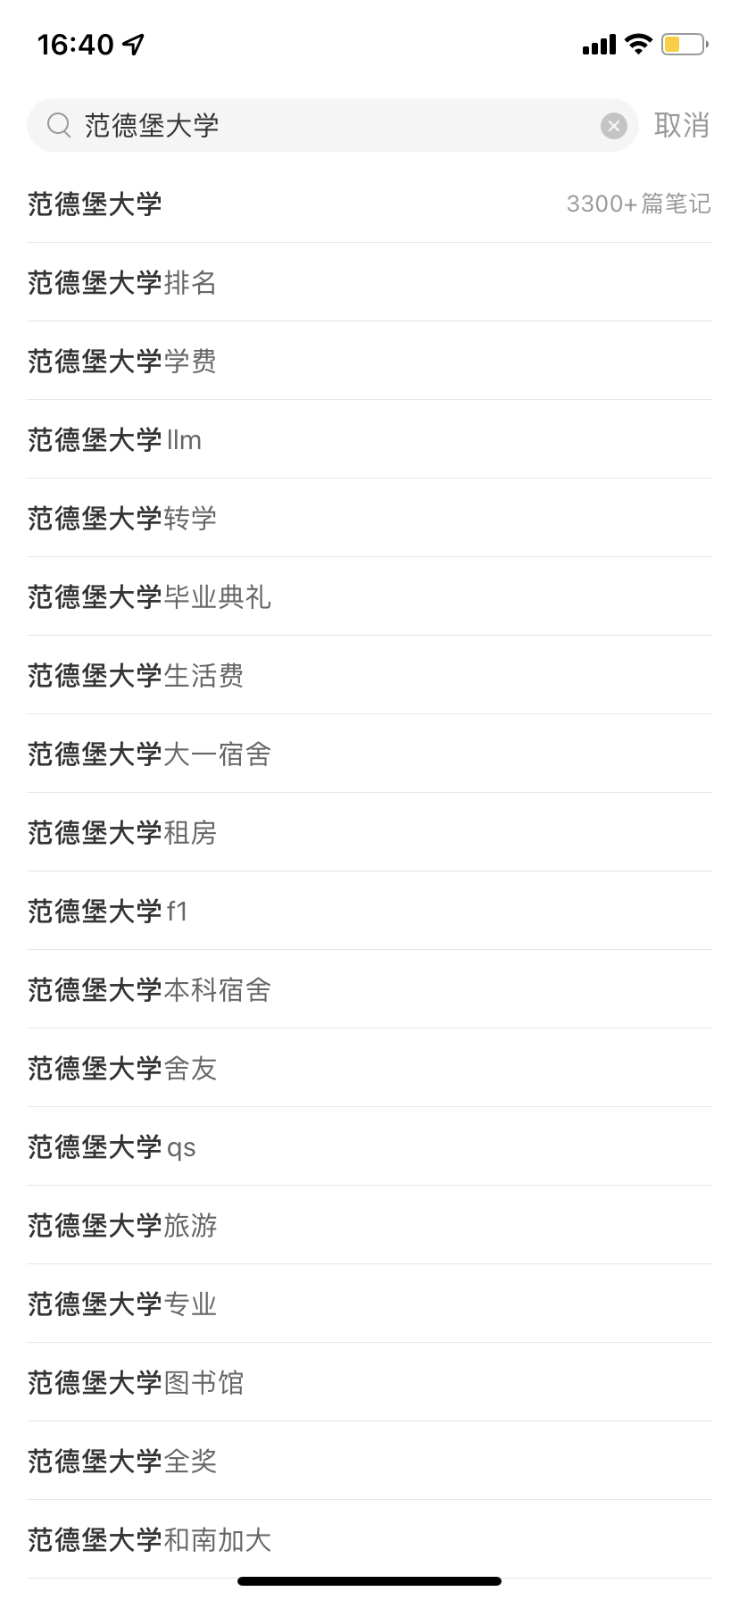
Social Media
Find the social media base on your needs
Input the name of the university
Click related keywords

Slide 19
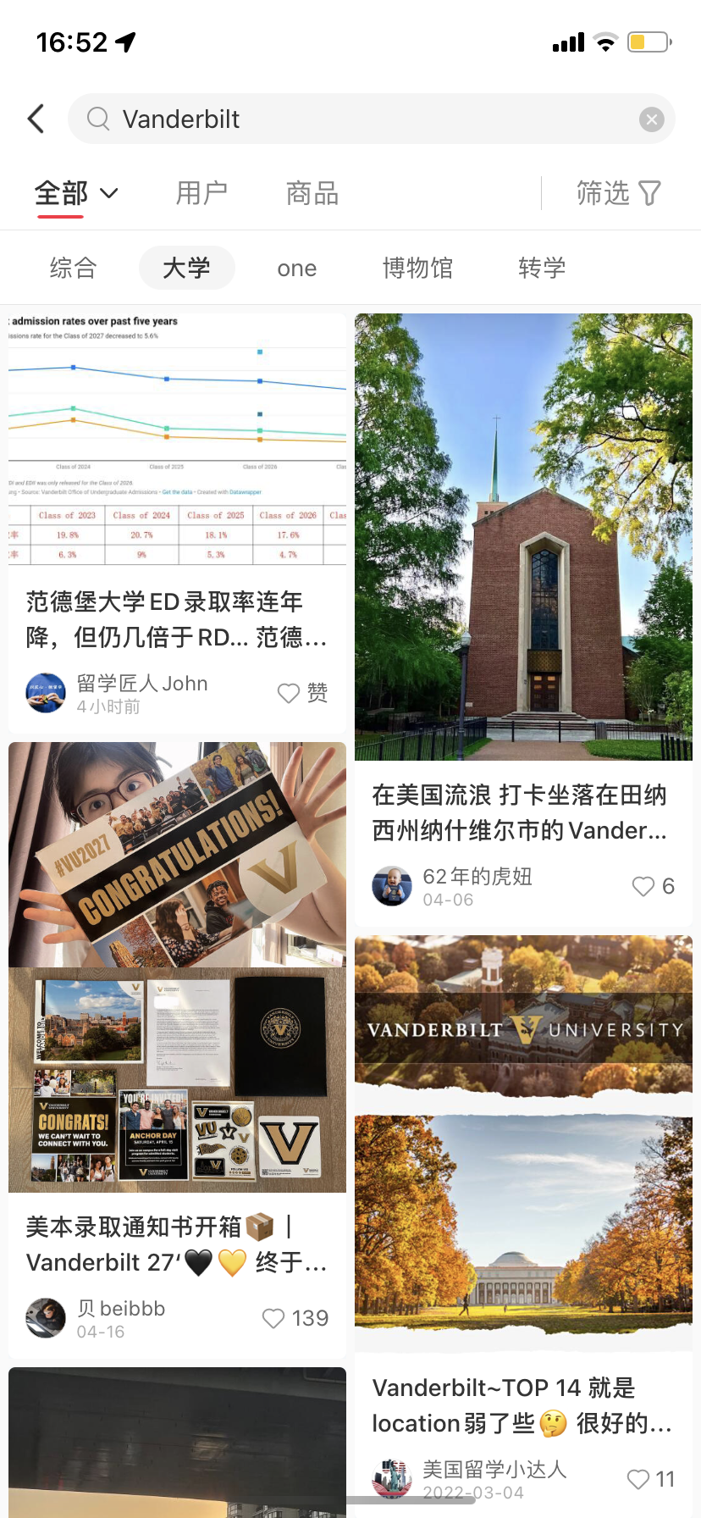
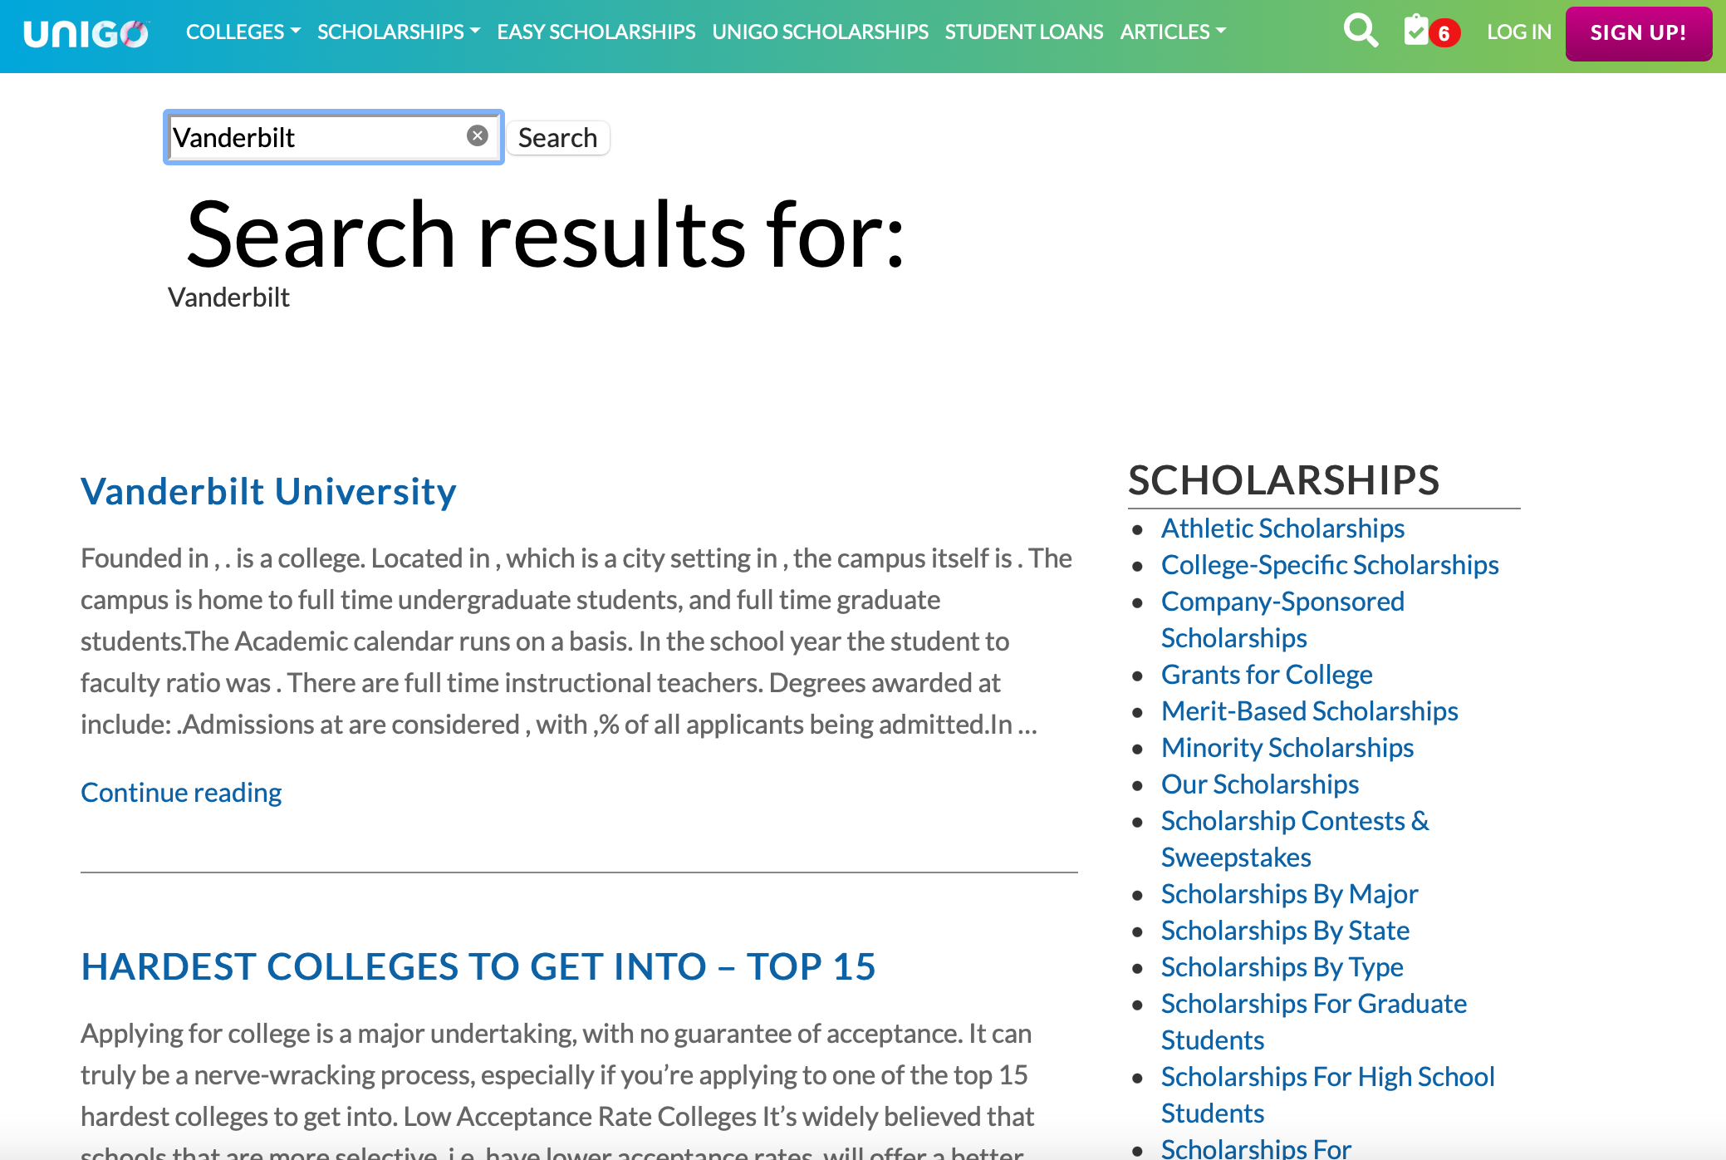
Social Media
Domestic social media: Information from international student’s perspective.
Foreign social media: More comprehensive information and source

Slide 20
THANK YOU FOR WATCH

